Slide 1


Data Preprocessing
By: Sidhidatri Nayak
CDAC,NOIDA,India

Slide 2
Notice regarding the usage of images:
This document contains images obtained by routine Google
Images searches. Some of these images may perhaps be under
copyright. They are included here for educational and
noncommercial purposes and are considered to be covered by
the doctrine of Fair Use. In any event they are easily available
from Google Images.

Slide 3
Handling Missing Values
Deleting Rows with missing values
Impute missing values for continuous variable
Impute missing values for categorical variable
Other Imputation Methods
Using Algorithms that support missing values
Prediction of missing values

Slide 4
Missing Values
There are a number of methods to deal with missing values in the data frame:
df.method() | description
dropna() | Drop missing observations
dropna(how='all') | Drop observations where all cells is NA
dropna(axis=1, how='all') | Drop column if all the values are missing
dropna(thresh = 5) | Drop rows that contain less than 5 non-missing values
fillna(0) | Replace missing values with zeros
isnull() | returns True if the value is missing
notnull() | Returns True for non-missing values

Slide 5
Feature Scaling
Feature Scaling is a technique to scale the independent features present in the data in a fixed range.
Data pre-processing activity.
bring all values to the same magnitudes\range.
Helps in speeding up the calculations in an algorithm .
Correct prediction
Scaling can make a difference between a weak machine learning model and a better one.

Slide 6
What is Feature Scaling?
Feature scaling is a data preprocessing step in machine learning that transforms numerical features to a common scale.
prevents features with larger ranges (like salary) from dominating those with smaller ranges (like age) and ensures all features contribute equally, leading to faster model convergence and better performance.
commonly using normalization (0 to 1 range) or standardization (mean 0, std dev 1).

Slide 7
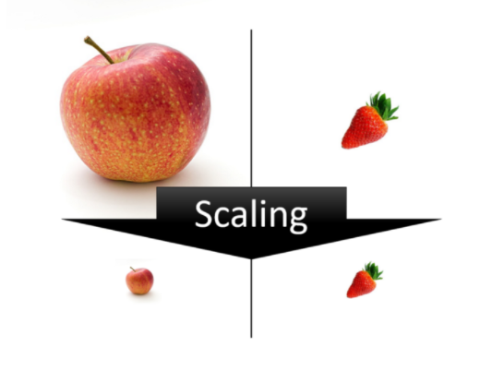
Why Feature scaling??

Slide 8
Why is feature scaling important
? ?
Equal Contribution: Prevents algorithms from giving undue importance to features with larger values.
Faster Convergence: Helps gradient descent and other optimization algorithms converge quicker.
Improved Performance: Crucial for distance-based algorithms (like KNN, SVM) and gradient descent-based models (like Neural Networks).

Slide 9
Feature Scaling Techniques
Standardization
Normalization
Binarization
Label encoder
One hot encoder

Slide 10
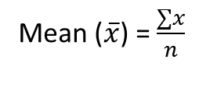
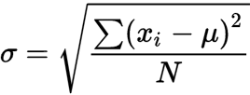
Standardization
Standardization is another scaling technique where the values are centered around the mean with a unit standard deviation.
mean of the attribute becomes zero and the resultant distribution has a unit standard deviation.
Technique is to calculate the statistical mean and standard deviation of the attribute values, subtract the mean from each value, and divide the result by the standard deviation.
Formula:
A value x is standardized as follows:
Scaled value of x = (x – mean) / standard_deviation

Slide 11
What is z-standardization?
Z-standardization is a statistical procedure used to make data points from different datasets comparable.
Each data point is converted into a z-score.
A z-score indicates how many standard deviations a data point is from the mean of the dataset.

Slide 12
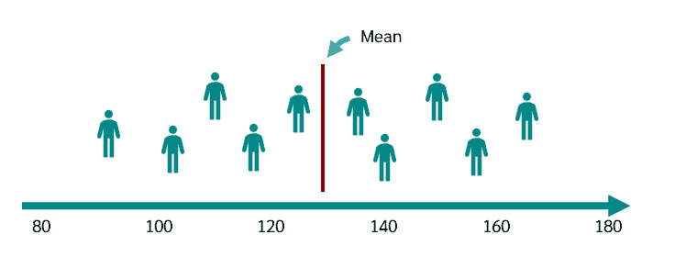
Example of z-standardization

Slide 13
For example…Blood pressure is 10mmHg above average.
Now the question arises, whether 10mmHg is a lot or a little.
The standard deviation tells us how much the data is spread out.
If the data are close to the mean, we have a small standard deviation
if they are widely spread, we have a large standard deviation.

Slide 14
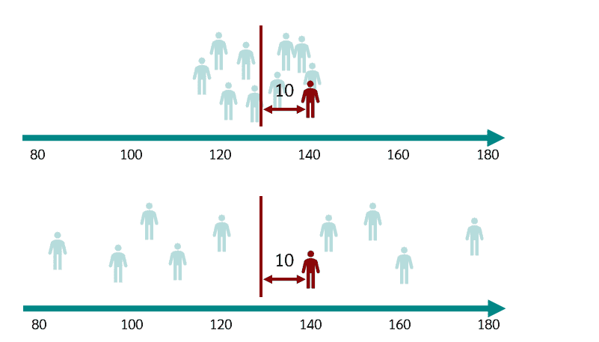

Slide 15
If the other patients cluster very closely around the mean, then 10mmHg is a lot in relation to the spread,
but if the other patients spread very widely around the mean, then 10mmHg might not be that much.

Slide 16
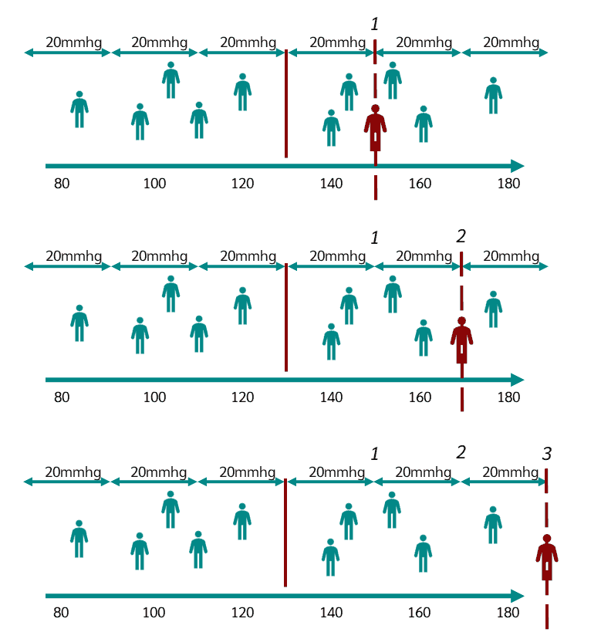

Slide 17
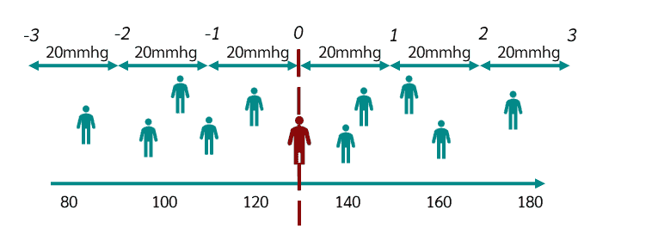

Slide 18
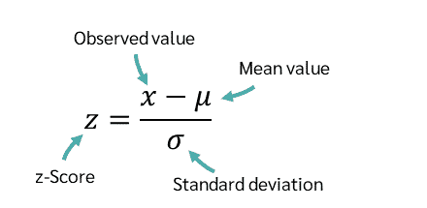
Z-score Formula

Slide 19
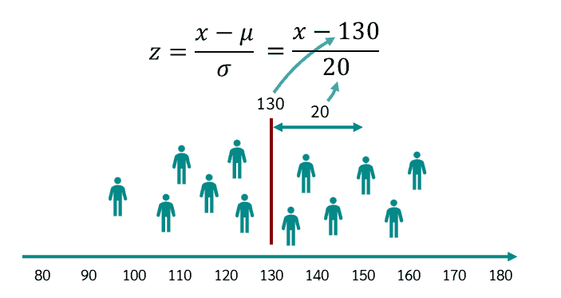

Slide 20
Let's say this patient has a blood pressure of 97
What will be the z-score value??

Slide 21
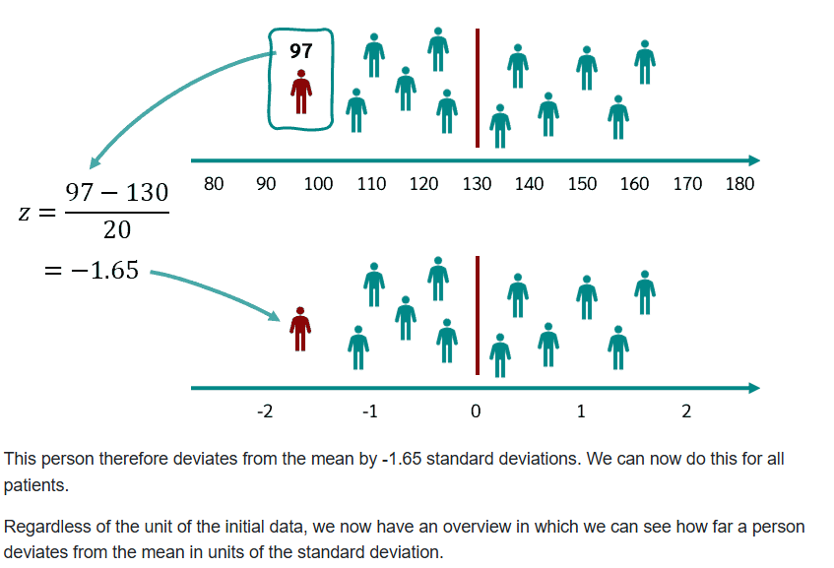

Slide 22
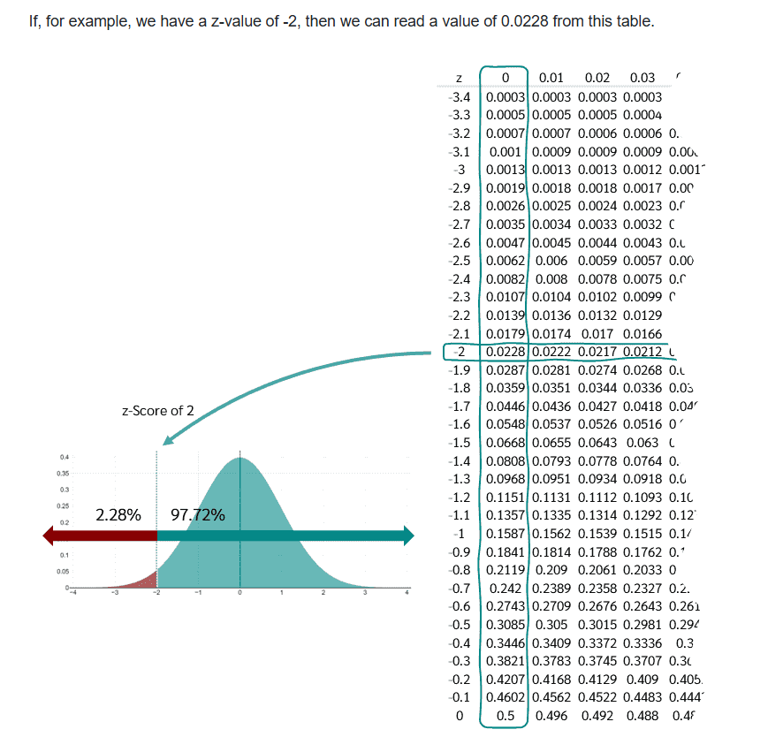

Slide 23
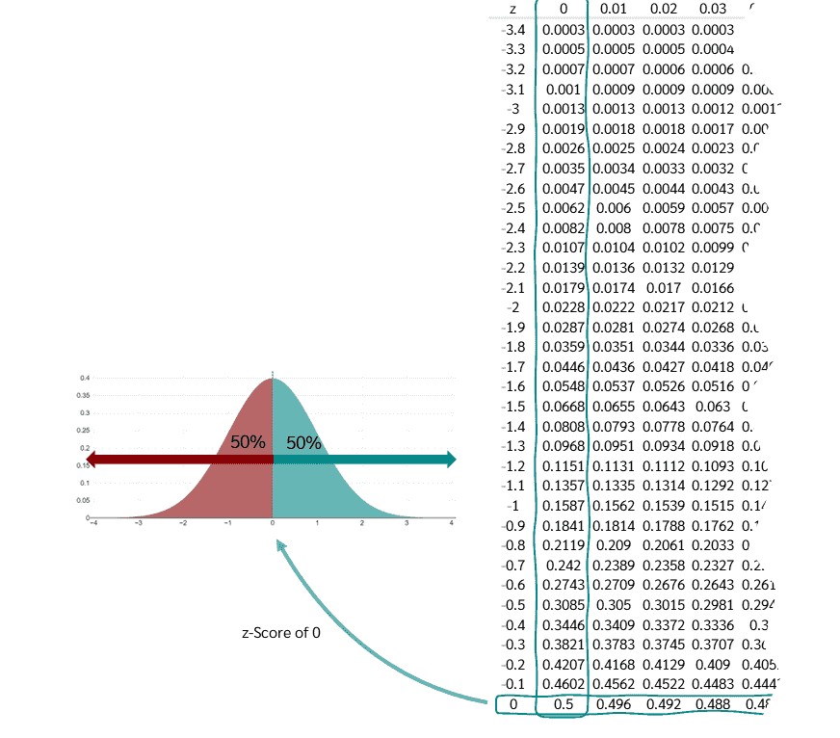

Slide 24
For example, if we want to know what percentage of patients have a blood pressure below 123???

Slide 25
A person who deviates by minus one standard deviation has a z-score of -1, a person who deviates by minus two standard deviations has a z-score of -2, and a person who deviates by minus three standard deviations has a z-score of -3.
And if a person has exactly the value of the mean, then they deviate by zero standard deviations from the mean and receive a score of zero.
The z-score indicates how many standard deviations a measurement is from the mean.
The standard deviation is just a measure of the dispersion of the patients' blood pressure around the mean.
So, the z-score helps us understand how exceptional or normal a particular measurement is compared to the overall average.

Slide 26
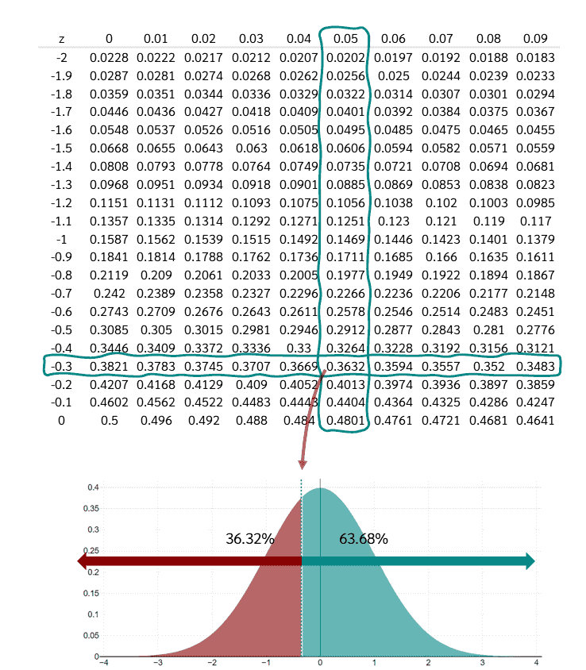

Slide 27
Conclusion
we have a value of 0.3632.
This means that 36.32 percent of the values are smaller than a z-value of -0.35 and 63.68 percent are larger.

Slide 28
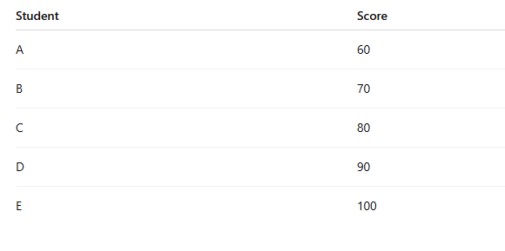
Example to calculate the z-score value

Slide 29
Mean=?
Standard deviation=?

Slide 30
Implementation in Python
The StandardScaler is a preprocessing class in scikit-learn (sklearn) that transforms numerical features
with mean = 0Standard deviation = 1
This process is called standardization or z-score normalization.

Slide 31
Important Methods in StandardScaler
Method | Description
.fit(X) | Learns mean and std for each feature
.transform(X) | Applies scaling using learned parameters
.fit_transform(X) | Does both in one step
.inverse_transform(X) | Converts standardized data back to original scale
.mean_ | Stores the learned mean
.scale_ | Stores the learned standard deviation

Slide 32
Normalization
Normalization is a rescaling of the data from the original range so that all values are within the new range of 0 and 1.
Attributes are often normalized to lie in a fixed range — usually from zero to one—by dividing all values by the maximum value encountered or by subtracting the minimum value and dividing by the range b
A value is normalized as following formula:
y = (x – min) / (max – min)
Where the minimum and maximum values pertain to the value x being normalized between the maximum and minimum values.

Slide 33
Min-Max scaler
We can apply the MinMaxScaler to normalize the input variables.
what will be the new value for any value x ?
new max=1 and new min =0
(X-minvalue/(max value-min value))*((new max-new min)+new min

Slide 34
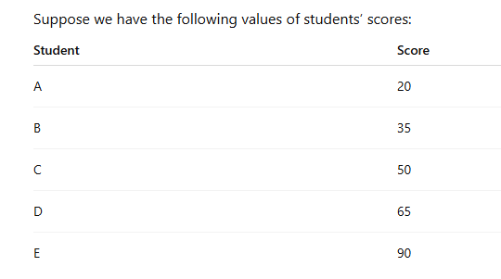

Slide 35
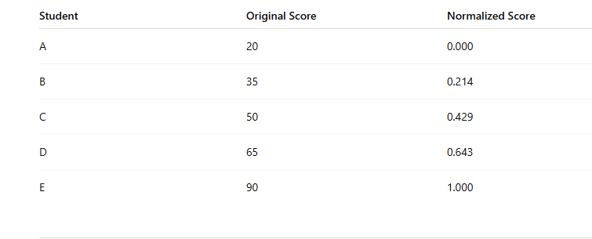
Normalized Dataset

Slide 36
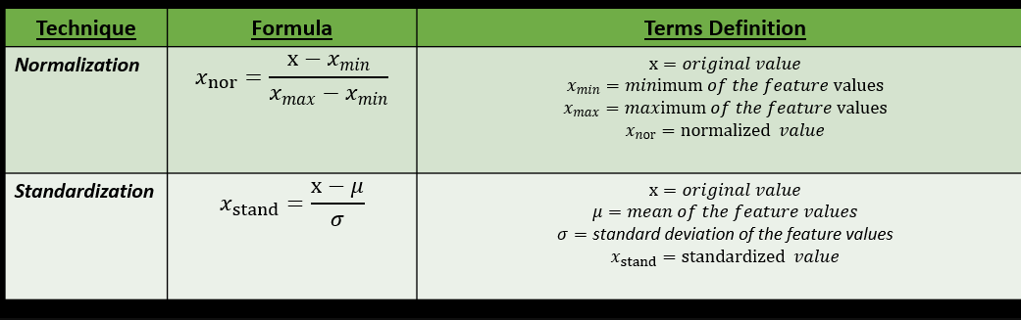

Slide 37
When to use Standardization and Normalization?

Slide 38
Best to use standardization when:
The mean and standard deviation of the feature values are known.
The feature distribution is assumed to be Gaussian (Normal).
The rescaled values doesn’t need to be in a fixed range.
When the input features need to be centered around mean.

Slide 39
Best to use Normalization when:
The minimum and maximum value of the feature are known.
The feature distribution is unknown or is not Gaussian (Normal).
The rescaled values need to be in a fixed range.

Slide 41
Why is it important to know the difference between Normalization and Standardization?
It helps you make informed decisions regarding data preprocessing when you are using a particular dataset and a particular machine learning model.
If this difference is ignored, it can lead to faulty predictions and unreliable results.

Slide 42
Binarization
The preprocessing.Binarizer() function binarizes data according to an imposed threshold. Values greater than the threshold map to 1, while values less than or equal to the threshold map to 0.

Slide 43
Label encoder and One hot encoding
Encode the levels of categorical features into numeric values.
LabelEncoder encode labels with a value between 0 and n_classes-1 where n is the number of distinct labels.
Where as one hot encoding takes a column which has categorical data, which has been label encoded and then splits the column into multiple columns. The numbers are replaced by 1s and 0s, depending on which column has what value.

Slide 44
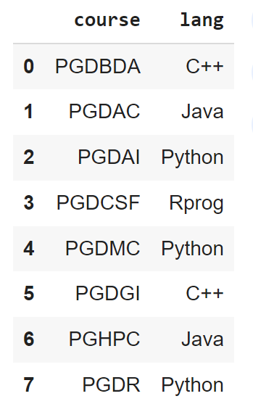

Slide 45
Thank You

